Slide 1
PAS2035 Delivery on the Ground

Slide 2
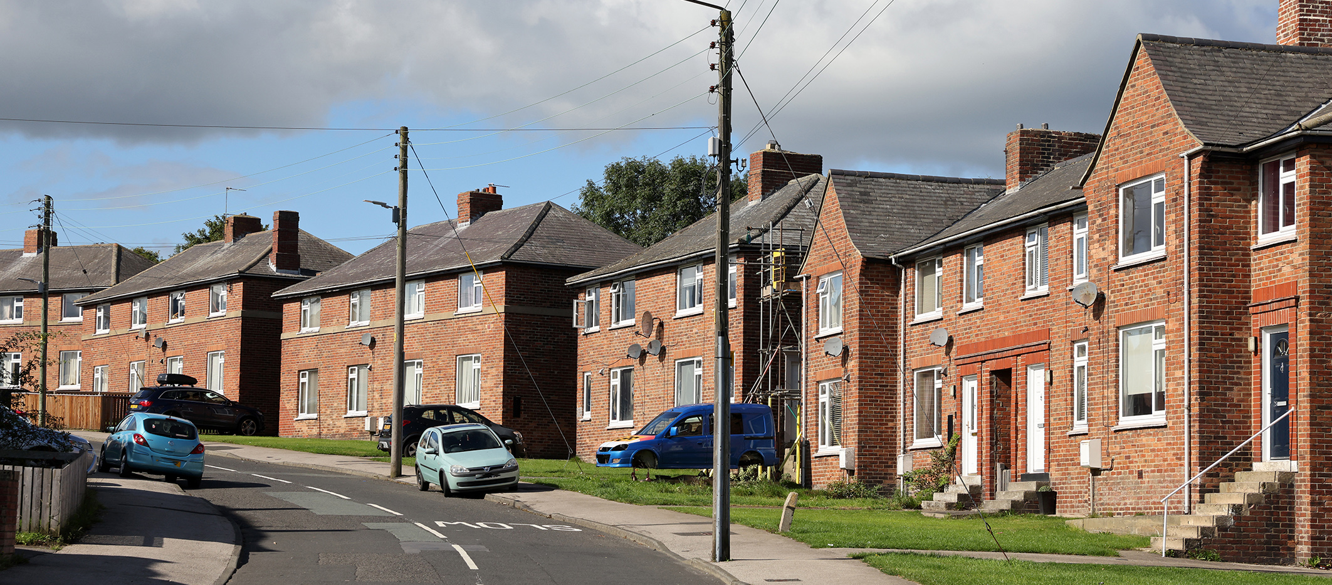
Social Housing Decarbonisation Fund W1 – Delivery

Slide 3
Challenges

Slide 4
Practical Learnings

Slide 5
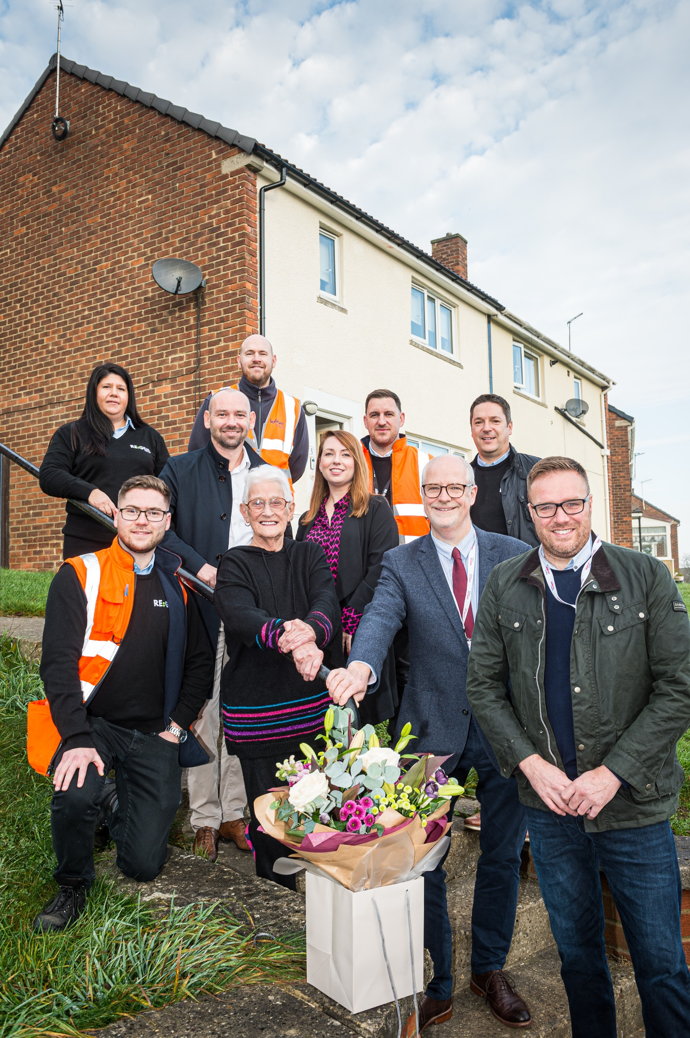
Supply Chain, Skills & Jobs

