Slide 1
Navigating PAS 2035
How do we ensure its intention is upheld, streamline costs and address the growing skills challenges?
Presented by
Claire Bailey-Jones, Head of Business Development Novus Property Solutions

Slide 2
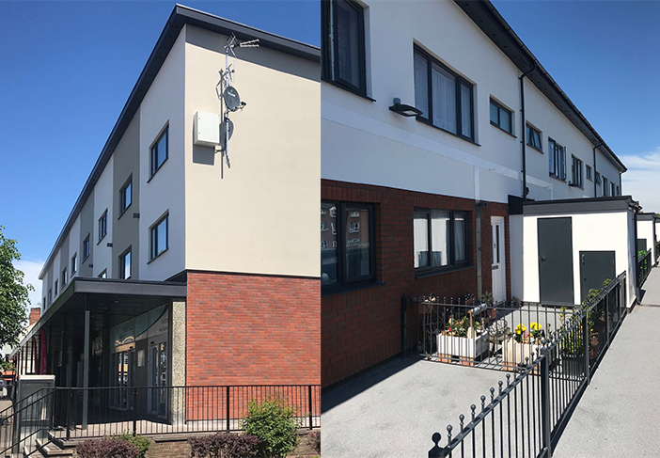
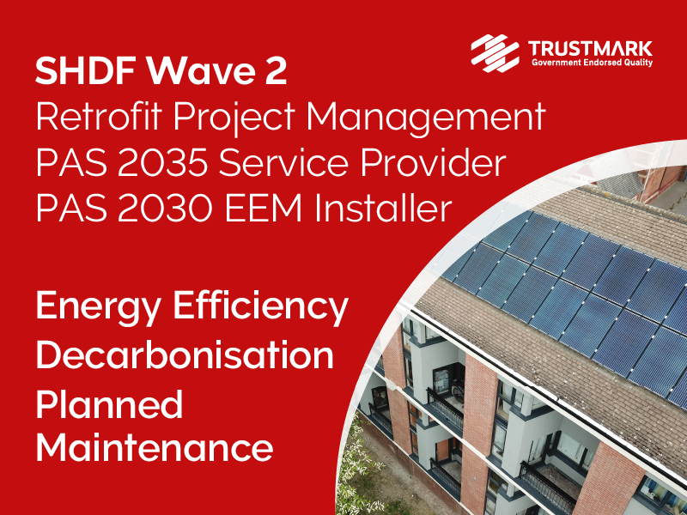
Who are Novus?
A Family-owned national maintenance contractor
PAS 2030 Installers and Trustmark Accredited
PAS 2035 compliant
Assisted over 20 clients through funding applications requiring PAS
Delivering Wave 1 schemes on the ground
Feasibility and Medium Term Retrofit Plans.
Navigating PAS 2035

Slide 3
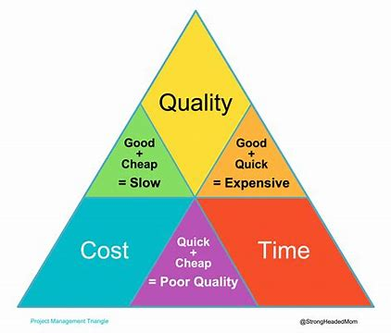
Funding v/s Delivery
Funding
BIM
Route to Net Zero
Delivery
Non-BIM
EPC ‘C’
Worst affected
Maximise Funding
Budget caps/Enabling works £
Navigating PAS 2035

Slide 4
Addressing the Skills Challenge
Skills
Retrofit Assessors
Retrofit Coordinators
Challenge
Attraction
Lack of understanding
Retrofit Designers
Retrofit Installers
Budget caps
Navigating PAS 2035

Slide 5
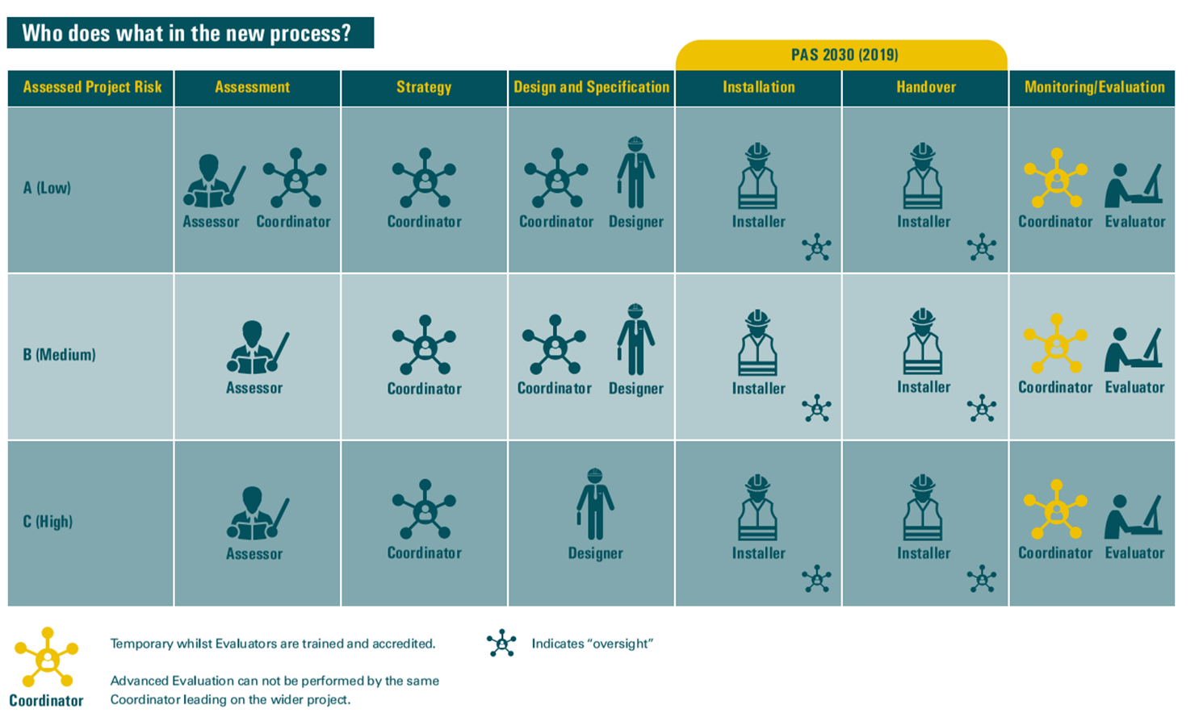
Summary
Understanding PAS:
what do you/your business need to know
Understand roles
Value for Money v/s cost – time/cost/quality review
Data is key:
Maintenance of stock
Accurate records
EPC C or route to net zero
Cost of enabling works – contingency
Collaboration in the sector to bridge the skills gap
Navigating PAS 2035

Slide 6
Thank You

Slide 7
PROUD OF OUR PROMISE

