Slide 1
Unlock Net Zero
PAS 2035: on the ground….
Arnout Andrews
arnout@retrofitacademy.org
07495 339 736

Slide 2
Learn to love PAS 2035!
Stop thinking of PAS 2035 as the ‘policeman of retrofit’.
PAS 2035 is your “friend with benefits”

Slide 3
Understand PAS 2035
Stages & Roles | Outcomes | Risk | Assessment | Design | Install | Evaluate
Coordinator
Assessor
Designer
Installer
Evaluator

Slide 4
Simple steps
“The longest journey starts with a single step.”
Some people need to really know PAS 2035
But most of you probably do not!
You DO NOT need to ‘learn PAS’ to start!
Connect with PAS 2035,
….. and it will work for you…..

Slide 5
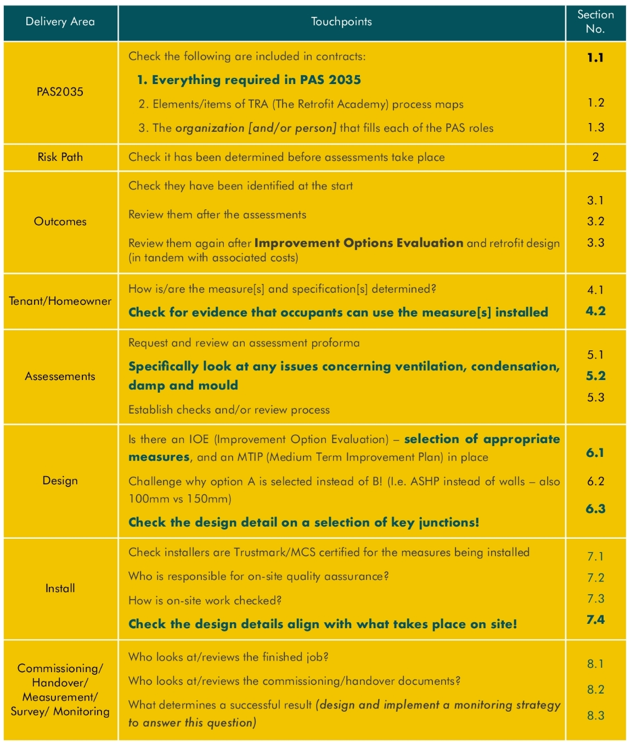
3 Things! (to start)
Contract: Roles and compliance in contracts.
Assessment: Ventilation, condensation, damp and mould
Selection of measures (and spec)
Design: Check construction details.
Install: Check details are being built
Check occupier can use what they have had
Notes:
Clarity on where the roles sit ASAP
RC ASAP!
Check construction details exist!
Check details are built

Slide 6
What do we need?
What are the 3 things that are needed to facilitate better delivery of retrofit?
My 3
Better pattern book solutions
Support structure for delivery of funded projects – transition to compliance regime later.
Better software for IOE’s

Slide 7
Where to go: Retrofit Academy resources
MEH toolkit web: https://retrofitacademy.org/midlands-toolkit/
Retrofit Academy Compliance process map web: https://retrofitacademy.org/pas-2035-compliance-map/
Supported Training: https://retrofitacademy.org/ select “Learn” from top banner, select an area from below “Available Funding”

