Slide 1
Oomph! Wellness Putting some Oomph! into the Community
David Terrace

Slide 2
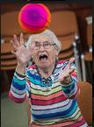
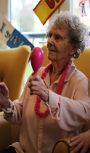
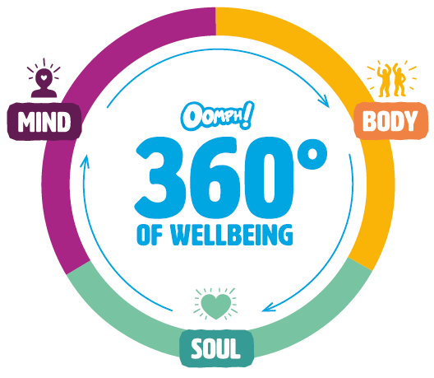
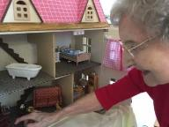
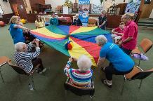
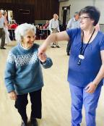
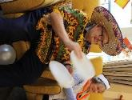
Our organisation makes people happy!
An award winning social enterprise dedicated to enhancing the mental, physical and emotional wellbeing of older adults

Slide 3
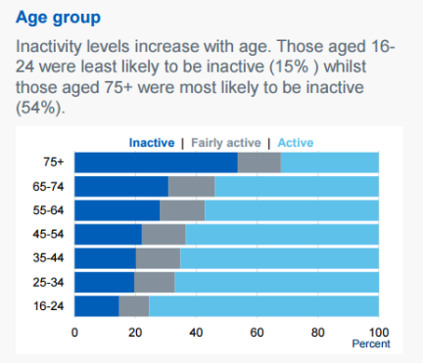
The problem
Increasing risk of:
• Reducing cognitive function
• Cardiovascular disease
• Inability to carry out daily living activities
• Reduced mood and self‑esteem
• Falls
https://www.gov.uk/government/uploads/system/uploads/attachment_data/file/613532/obes-phys-acti-diet-eng-2017-rep.pdf

Slide 4
Our solution
Take physical activity to where older people live or go regularly
Fun, engaging and adaptable sessions
Make the most of the expertise within these settings, through training and support

Slide 5
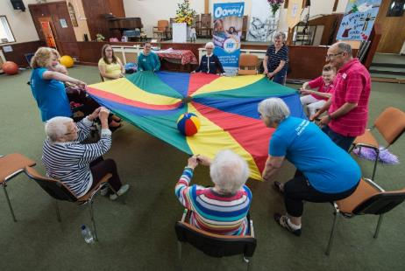
What makes up the sessions?
Gamification
Inclusive competition
Contemporary music
Themes and imagery

Slide 6
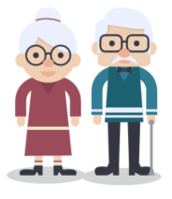
CSPs identify most suitable venues in area
Public health/local authorities can signpost to classes in local area
CSPs and NGBs can identify local clubs or groups if the person would like to do more
Lives in
Join group
Physical activity becomes part of the culture
Goes to
Join group
Oomph receives real time data from tablets therefore can proactively manage performance.
Oomph! provides accredited training, materials and support to staff already at the venues to lead physical activity classes

Slide 7
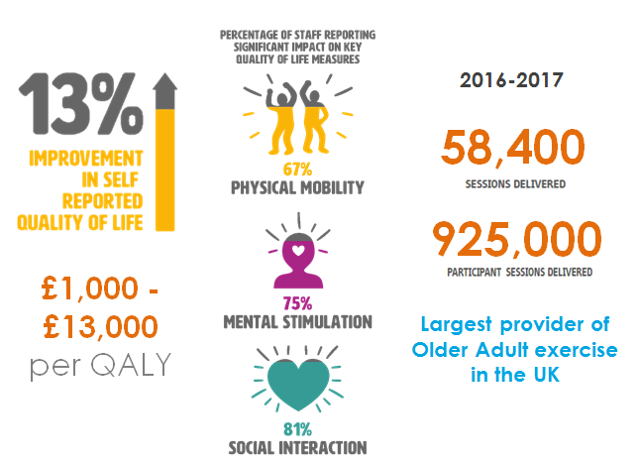
Our track record in delivering outcomes

Slide 8
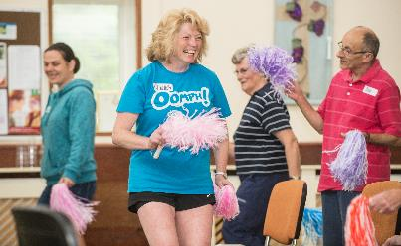
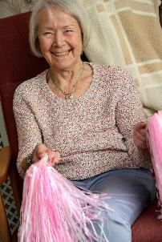
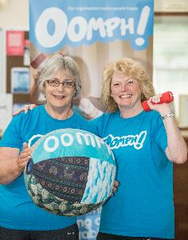
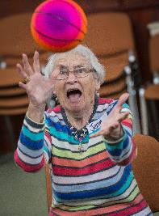
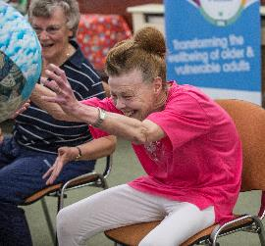
The most important outcome

Slide 9
More than just training
Ongoing support to make the sessions habitual for older people and staff
Face to face and telephone support
Monthly energisers and new material to keep things interesting
Quarterly management reporting
Through a charging a small amount per person (£1-2) organisations can cover the cost of the annual licence and generate a sustainable profit for the host organisation.

Slide 10
How can you get some Oomph?
We’re looking to work with extra care, sheltered housing and independent living providers to embed a culture of fun, wellbeing and activities.
If you are interested in talking further please contact:
David Terrace – Head of Community Partnerships
david@oomph-wellness.org
07463113259
We looking forward to working with you!

