Slide 1
Hact – civic INNOVATION 2017: POOPRINTS.UK
DOG DNA REGISTRATION
CREATING BETTER, CLEANER, SAFER PLACES TO LIVE.
Gary Downie
Tuesday June 28^{th ,} 2017

Slide 2
core proposition
Why DNA register dogs in housing?
Well defined problem. Dog fouling is consistently raised as a resident concern. Add dog owner accountability.
DEFLECT LIABILITY.
Increased bottom line. Save money on maintenance costs & complaints. Increase neighbourhood appeal. LOW COST SOLUTION: £35 PER DOG.
Environmentally friendly. Easy to implement via pet policy or tenancy agreements.
WWW.POOPRINTS.UK

Slide 3
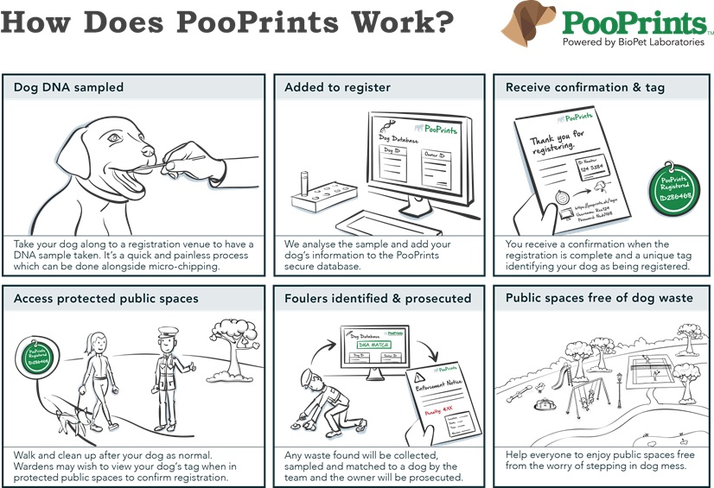
HOW IT WORKS

Slide 4
STRATEGIC APPROACH
Inconsiderate dog ownership is a community problem.
Better, Cleaner, Safer places via PooPrints Dog DNA Registration.
Whole Community
Communicate dog DNA as a new strategy
Experiences service in action, provides feedback
Non Dog Owners
1-in 4 homes own a dog in the UK.
PooPrints has a 95% success rate across the US and Canada in reducing incidences of uncollected dog waste.
PooPrints is a permanent, long term resolution.

Slide 5
Hact – civic INNOVATION 2017: POOPRINTS.UK
We would like to pilot WITH HOUSING ASSOCIATIONS TO DEVELOP AN END-TO-END SERVICE JOURNEY.
COME AND DISCUSS THIS OPPORTUNITY WITH US.
WWW.POOPRINTS.UK

